Slide 1
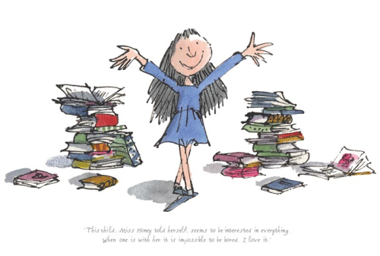
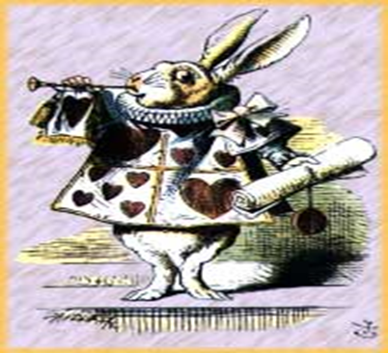
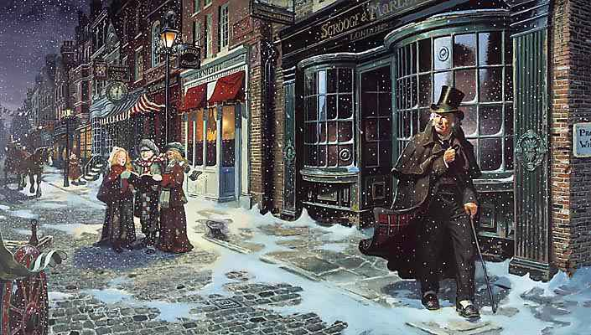
The Performing Arts Club St Johns Our Story so far...
Matilda: A Musical
Scrooge
A Musical
A Fairytale Musical

Slide 2
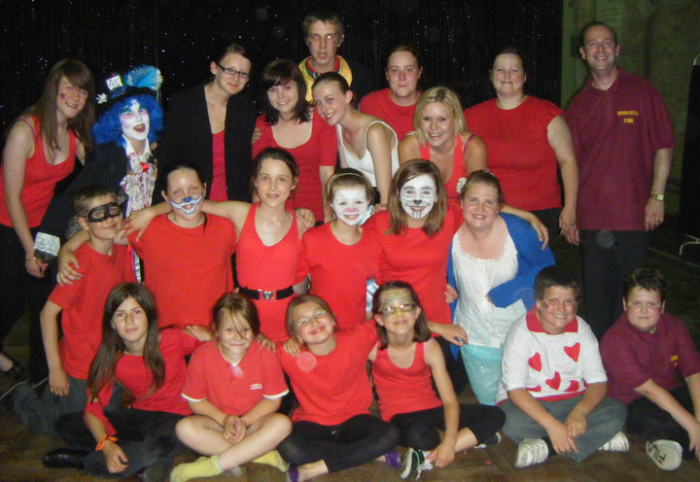
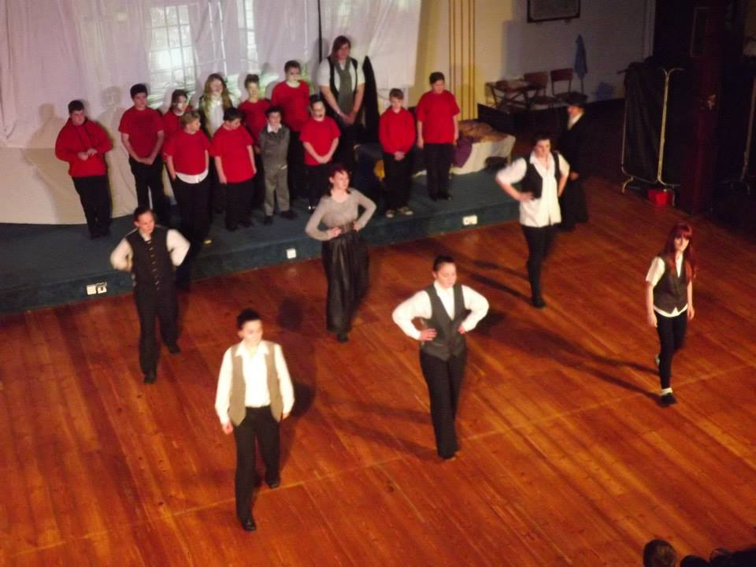
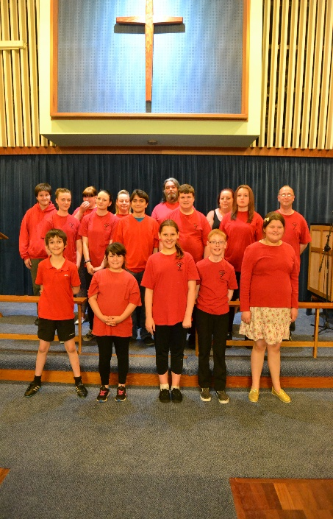
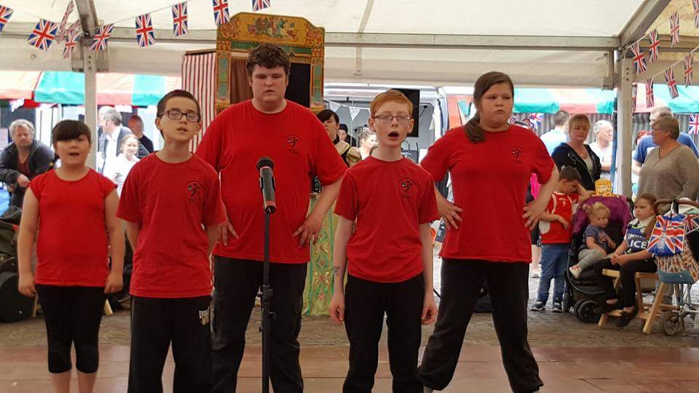
The PACS Casts..Past to Present

Slide 3
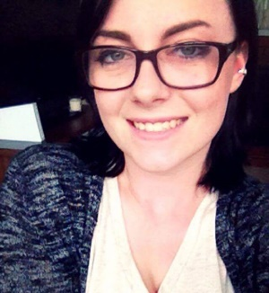
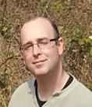
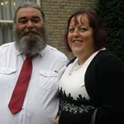
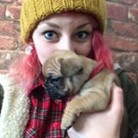
The PACS Crew..
Choreographer - Bryony
Musical & Technical Director - Rick
Drama Director - Mick
Production Assistant - Katie
Our Volunteers..
Debbie, Sue, Tracey, Calum and Shayne.

Slide 4
On behalf of PACS Members and Volunteers..
We sincerely thank you for supporting our event today..
To find out more
Tel………...01427 612870 E-Mail……pacs2012@yahoo.co.uk
Website…
www.performingartsclubstjohns.co.uk
Twitter: @pacs2012rick

Slide 5
The Performing Arts Club St Johns now proudly presents…
“At The Movies”
Christmas Special
2016

